Slide 1
IBM Data Science Capstone Project
Murugappan Sivabalan

Slide 2
Outline
Executive Summary
Introduction
Methodology
Results
Conclusion
Appendix

Slide 3
Executive Summary
Summary Of methodologies
Data Collection
Data Wrangling
Exploratory Data Analysis with Data Visualisation
Exploratory Data Analysis with SQL
Creating an Interactive map with Folium
Building a Dashboard with Plotly Dash
Predictive Analysis (Machine Learning: Classification)
Summary of results
Summary of results
Exploratory Data Analysis results
Interactive analytics in screenshots
Predictive Analytics results

Slide 4
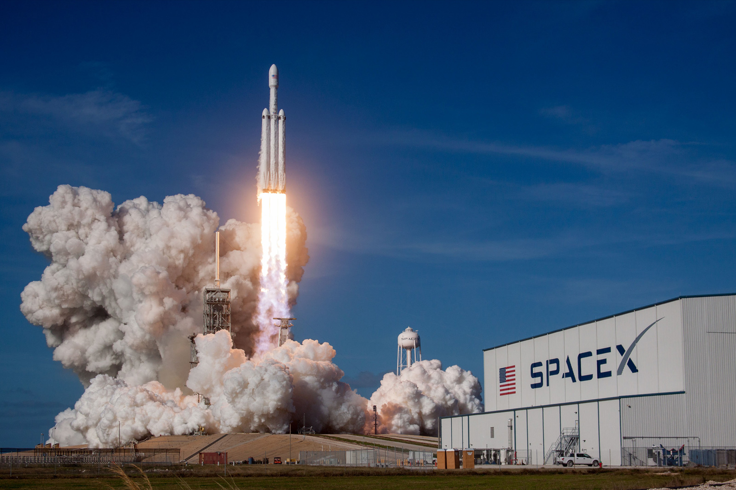
Introduction
Project Background and Context
SpaceX, a leading company in the commercial space industry, has revolutionized space travel by making it more affordable. The company advertises Falcon 9 rocket launches at a cost of 62 million dollars, while other providers charge up to 165 million dollars. Much of this cost difference is due to SpaceX's ability to reuse the first stage of its rockets. By determining if the first stage will successfully land, we can predict the cost of a launch. This information is vital for any company looking to bid against SpaceX for a launch contract. This project aims to create a machine learning model to predict the likelihood of a successful first-stage landing.
Questions:
What factors influence the success rate of the first stage landing, such as payload mass, launch site, and flight number?
How do interactions among these features affect the landing success rate?
Does the rate of successful landings improve over time?
What are the best operating conditions to ensure a successful landing program?
What is the most suitable algorithm for binary classification in this scenario?

Slide 5
Methodology
Data Collection
Data Wrangling
Exploratory Data Analysis with Data Visualisation
Exploratory Data Analysis with SQL
Creating an Interactive map with Folium
Building a Dashboard with Plotly Dash
Predictive Analysis (Machine Learning: Classification)

Slide 6
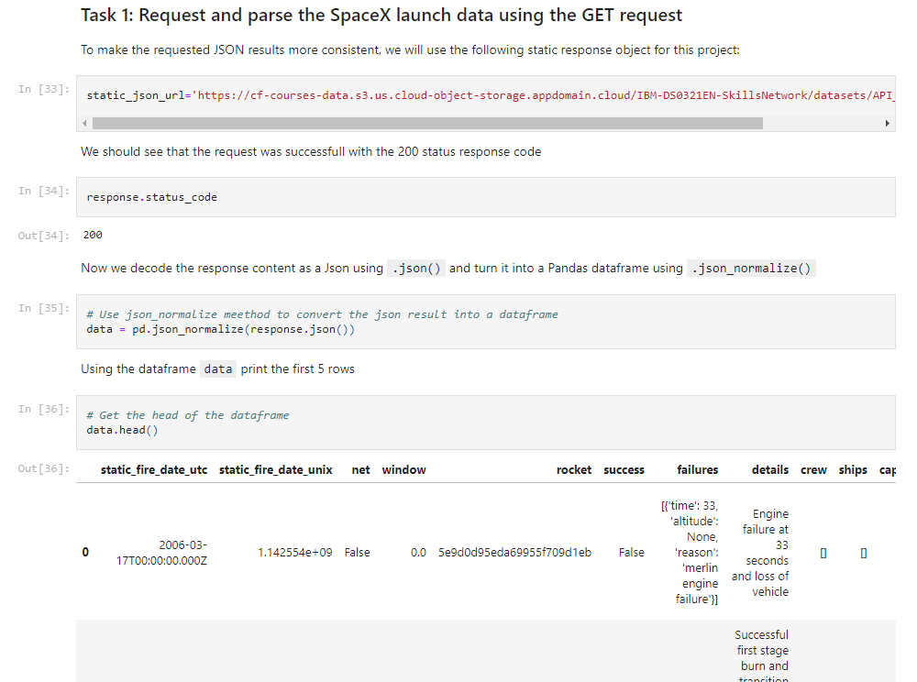
Data Collection
Data Collection Process - SpaceX API
The data collection process began with accessing the SpaceX REST API to gather detailed information about Falcon 9 launches.
API Request: I sent GET requests to the SpaceX API, retrieving data points such as Flight Number, Date, Booster Version, Payload Mass, Orbit, and Launch Site. This information was crucial for understanding the various factors that influence the success of the first stage landing.
Data Processing: The response was decoded using the .json() method, and the data was normalized into a pandas DataFrame using json_normalize(). This step allowed us to structure the JSON data into a tabular format suitable for analysis.
Data Cleaning: I performed extensive data cleaning, including checking for missing values and filling them where necessary. This ensured the accuracy and reliability of the dataset.
Data Storage: Finally, the processed data was exported into a CSV file for further analysis, maintaining a clean and organized structure throughout the process.

Slide 7
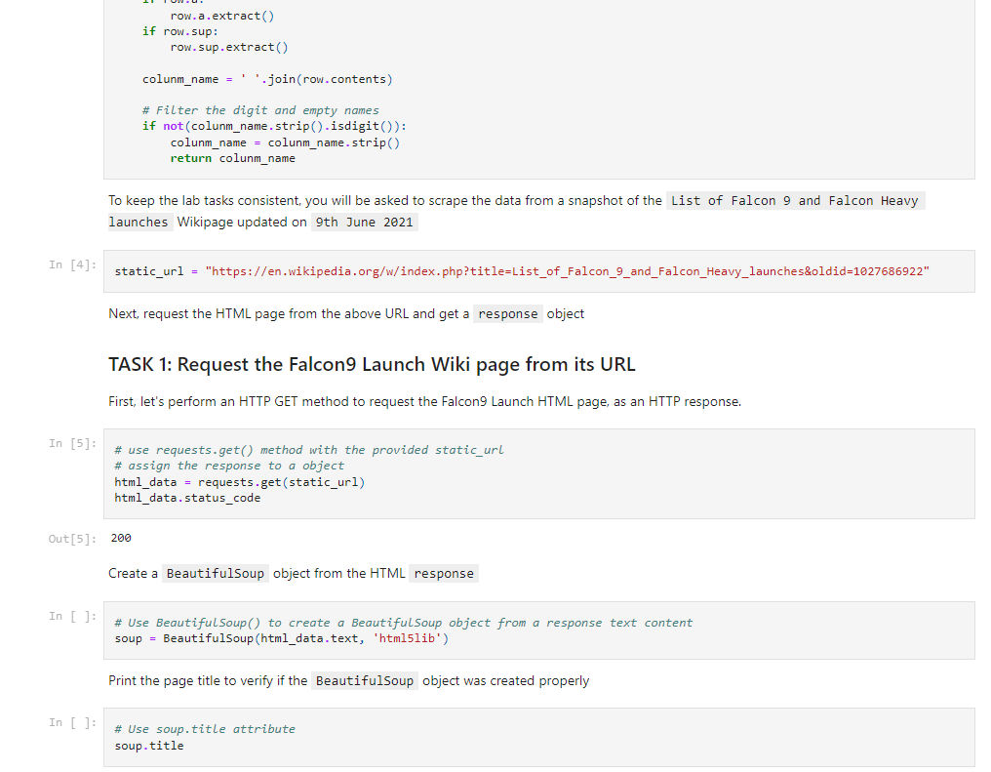
Data Collection
Data Collection Process - Web Scraping
In addition to using the SpaceX API, I employed web scraping techniques to collect supplementary data from Wikipedia.
Web Scraping Implementation: Utilized BeautifulSoup to parse HTML content from Falcon 9 launch records on Wikipedia. This allowed me to extract additional data points, such as Payload, Version Booster, Customer, and Launch Outcome.
Data Parsing: The HTML tables were parsed, and relevant data was extracted into a structured format. We then converted this data into a pandas DataFrame, ensuring consistency with the API-collected data.
Data Integration: The web-scraped data was combined with the API data, providing a more comprehensive dataset for our analysis. This dual approach ensured that no critical information was missed during the data collection process.
Data Export: Similar to the API data, the web-scraped information was also exported to a CSV file, ready for the next steps in our machine learning pipeline.

Slide 8
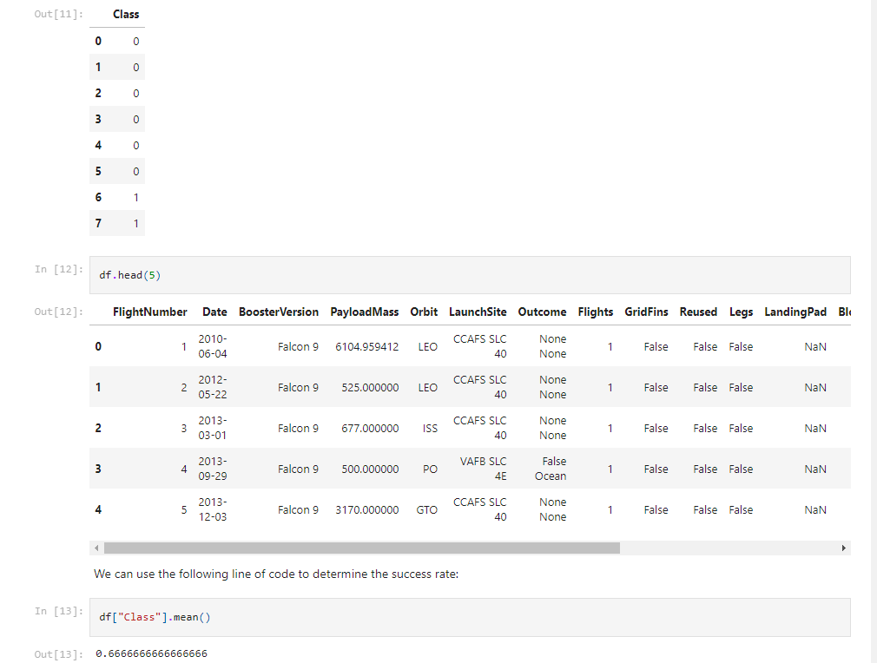
2. Data Wrangling
During the data wrangling phase, I performed essential steps to prepare the dataset for analysis and model training:
Exploratory Data Analysis (EDA): Analyzed the dataset to identify missing values and anomalies, which guided the creation of accurate training labels.
Mission Outcome Labeling: The mission outcomes were classified into binary labels: "1" for successful landings and "0" for unsuccessful attempts. This included different scenarios like landings on ocean, land, or drone ships.
Launch and Orbit Calculations: Calculated the number of launches at each site and the frequency of each orbit type. This analysis helped in understanding the conditions influencing landing success.
Final Data Export: After cleaning and labeling, the data was exported into a CSV file, ready for further machine learning analysis.

Slide 9
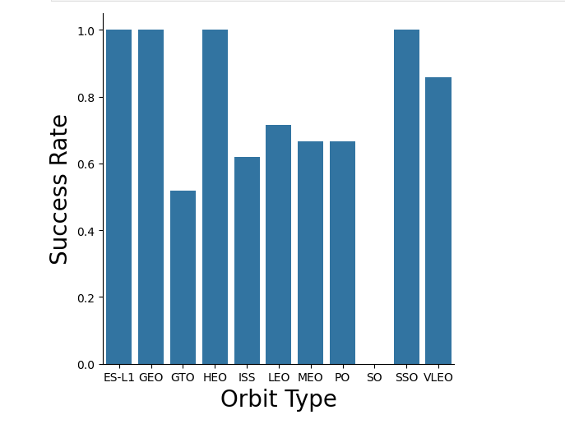
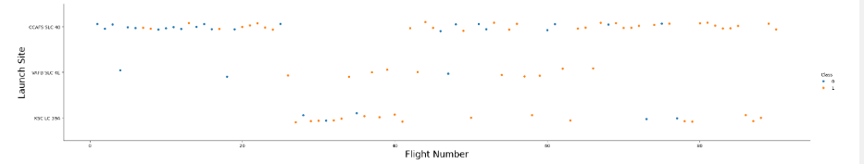
3. Exploratory Data Analysis with Data Visualisation
During the Exploratory Data Analysis (EDA), we visualized various relationships in the dataset to uncover patterns and trends:
Visualized Relationships:
Flight Number vs. Payload Mass
Flight Number vs. Launch Site
Payload Mass vs. Orbit Type
Success Rate by Orbit Type
Launch Success Yearly Trend
Chart Types:
Scatter Plots: Highlighted the relationships between different variables, helping to identify potential features for the machine learning model.
Bar Charts: Compared discrete categories to show the relationship between specific variables and their measured outcomes.
Line Charts: Tracked trends over time, especially in success rates, offering insights into temporal patterns.
This visualization-driven approach was crucial in shaping the direction of our analysis and model development.

Slide 10
4. Exploratory Data Analysis with SQL
I integrated the SpaceX dataset into a PostgreSQL database directly within the Jupyter notebook to perform SQL-based Exploratory Data Analysis (EDA). Through SQL queries, I extracted valuable insights from the data, such as:
Unique Launch Sites: Identified distinct launch sites used in space missions.
Payload Mass Analysis: Calculated total and average payload mass, including specifics for NASA (CRS) missions and Booster Version F9 v1.1.
Mission Outcomes: Analyzed the total number of successful and failed mission outcomes.
Booster and Landing Details: Investigated failed landings on drone ships, booster versions with maximum payload mass, and significant launch sites.
Timeline Analysis: Ranked landing outcomes over specific time periods to observe trends and improvements.
This approach allowed me to efficiently query and explore the dataset, providing a deeper understanding of the factors influencing mission success.

Slide 11
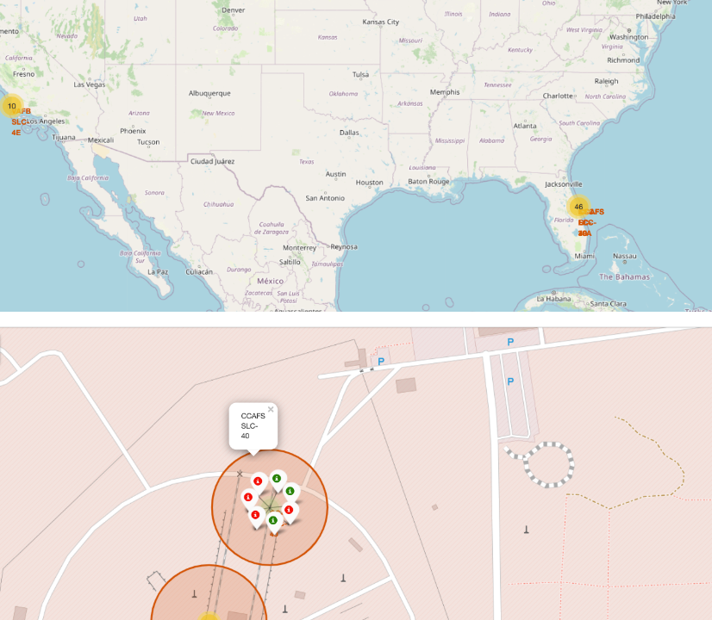
5. Interactive Map with Folium
I built an interactive map using Folium to visualize SpaceX launch sites and their outcomes:
Launch Site Markers: I added markers, circles, and lines to represent all launch sites. Each marker was tagged with the site’s latitude and longitude coordinates, displaying its geographic location and proximity to key areas like the Equator and coastlines.
Launch Outcome Indicators: I assigned launch outcomes (success or failure) to binary classes—0 for failure and 1 for success. Using color-coded markers (green for success, red for failure), I identified which launch sites had higher success rates by clustering them on the map.
Distance Calculations: I calculated and visualized the distances between launch sites and their proximities to important infrastructures like railways, highways, and coastlines. For example, I explored whether launch sites are strategically placed away from urban areas or near critical logistics routes.
This interactive map was a crucial tool for understanding the spatial relationships and factors contributing to the success of SpaceX missions.

Slide 12
6. Dashboard with Plotly Dash
I developed an interactive dashboard using Plotly Dash to visualize key metrics from the SpaceX dataset:
Launch Sites Dropdown: I added a dropdown menu to allow users to select different launch sites for a more focused analysis.
Pie Charts: I created pie charts to display the total number of successful and failed launches across all sites. When a specific launch site is selected, the chart dynamically updates to reflect that site’s success and failure counts.
Payload Mass Slider: To provide flexibility in the analysis, I implemented a slider that lets users adjust the range of payload mass values being analyzed.
Scatter Plot: I plotted a scatter chart to illustrate the relationship between payload mass and launch success rates for different booster versions. This helped in identifying trends and correlations in the data.
This dashboard enabled an interactive exploration of the SpaceX launch data, making it easier to draw insights and identify patterns.

Slide 13
7. Predictive Analysis
I conducted predictive analysis using classification techniques to model and predict outcomes:
Data Preparation: I loaded the data using NumPy and pandas, transformed it, and split it into training and testing sets.
Model Building: I built various machine learning models and fine-tuned hyperparameters using GridSearchCV to identify the best-performing model.
Evaluation Metrics: Accuracy was used as the primary metric. I improved the model by applying feature engineering and tuning algorithms.
Model Selection: After evaluating several models, I identified the best-performing classification model based on accuracy, Jaccard score, and F1 score.
This approach enabled me to develop a robust predictive model tailored to the dataset's characteristics.

Slide 14
Results
Exploratory Data Analysis results
Interactive analytics in screenshots
Predictive Analytics results

Slide 15
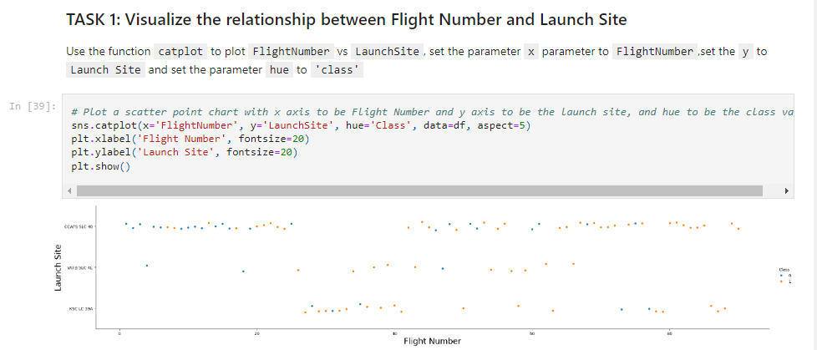
Exploratory Data Analysis
Flight Number VS Launch Site
Success Rates Improve Over Time: The analysis shows that earlier flights were more likely to fail, but as time progressed, the success rate at all launch sites has generally increased, reflecting advancements in technology and operational procedures

Slide 16
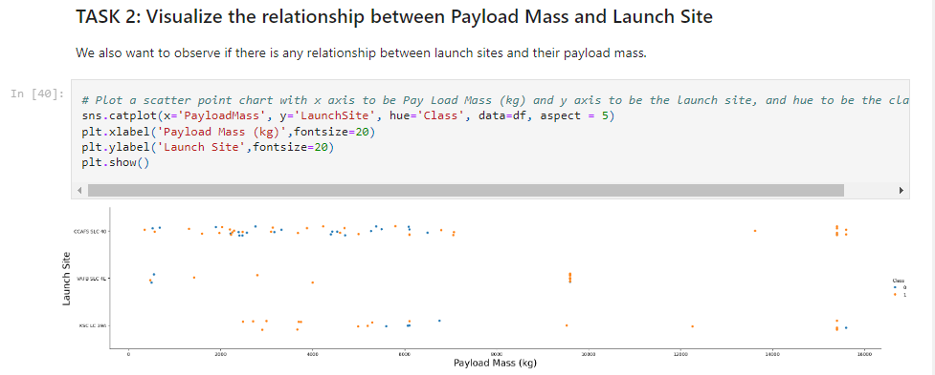
1(i). Exploratory Data Analysis with Visualisation
Payload VS Launch Site
Higher Payload Mass Correlates with Success: The data indicates that for every launch site, higher payload masses generally result in higher success rates, with KSC LC 39A showing a 100% success rate even for payloads under 5500 kg.

Slide 17
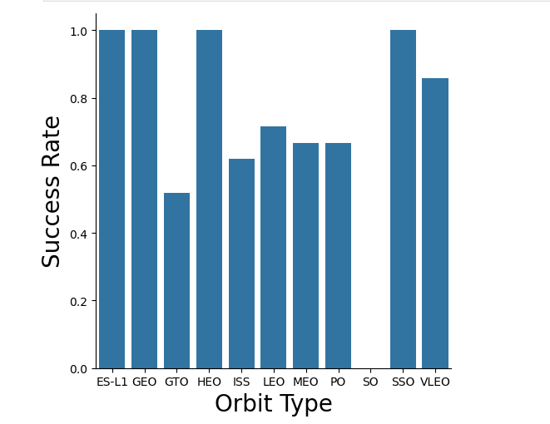
1(i). Exploratory Data Analysis with Visualisation
Success rate VS Orbit type
High Success Rates in Specific Orbits: The orbits ES-L1, GEO, HEO, and SSO have a 100% success rate, indicating strong reliability in these orbit types compared to others.

Slide 18
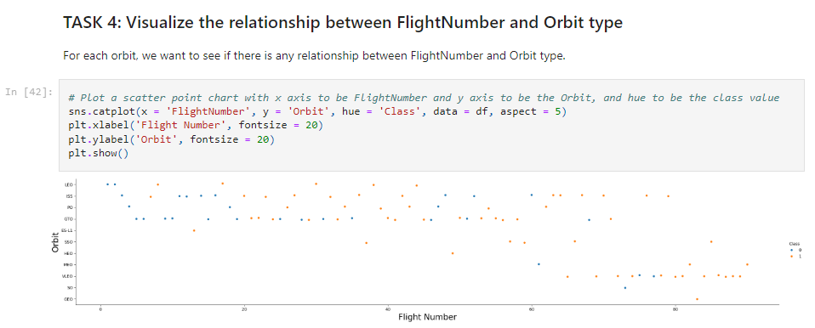
1(i). Exploratory Data Analysis with Visualisation
Flight Number VS Orbit type
LEO Orbit Shows Correlation: In the LEO orbit, the success rate seems to increase with the number of flights, while in the GTO orbit, there is no apparent relationship between flight number and success

Slide 19
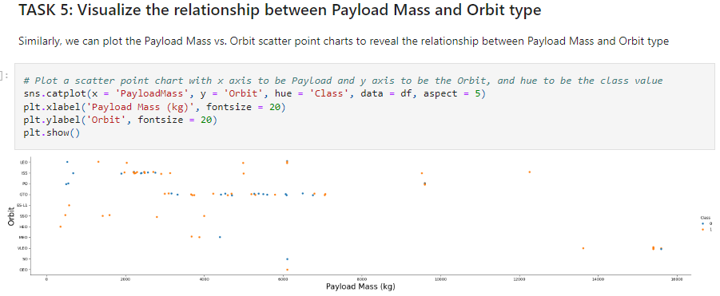
1(i). Exploratory Data Analysis with Visualisation
Payload Mass VS Orbit type
Impact of Heavy Payloads: Heavy payloads tend to negatively affect success in GTO orbits but have a positive influence on success rates in Polar LEO (ISS) orbits.

Slide 20
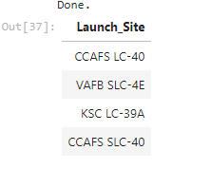
1(ii). Exploratory Data Analysis with SQL
All Launch Site Names
Querying Unique Launch Sites: Displaying the names of the unique launch sites

Slide 21
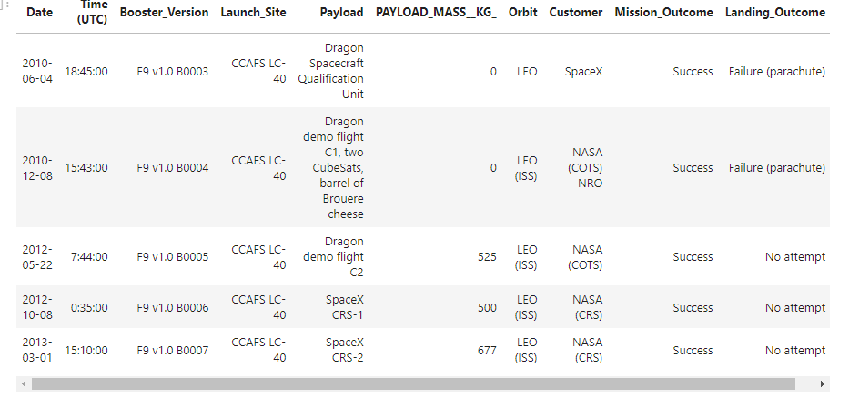
1(ii). Exploratory Data Analysis with SQL
Launch Site Names begin with ‘CCA’
Querying Launch Sites: A SQL query was used to retrieve records of launch sites that begin with 'CCA', showing that all results are for the site CCAFS LC-40.

Slide 22
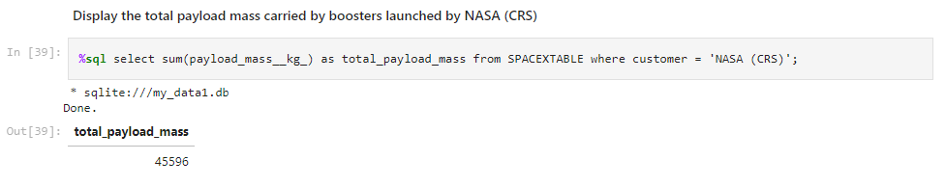
1(ii). Exploratory Data Analysis with SQL
Total Payload Mass
Querying total Payload Mass: Calculated total payload mass from NASA as 45596 using the query below

Slide 23
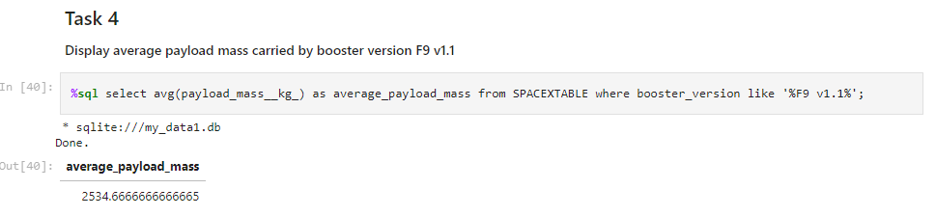
1(ii). Exploratory Data Analysis with SQL
Average Payload Mass
Querying average Payload Mass: Calculated average payload mass as 2534 using the query below

Slide 24
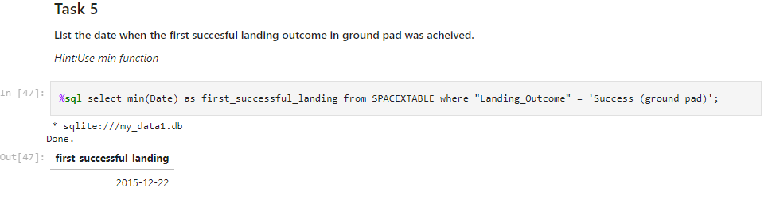
1(ii). Exploratory Data Analysis with SQL
First Successful Ground Landing
Querying first successful ground landing: Calculated first successful ground landing as 22nd December 2015 using the query below

Slide 25
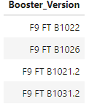
1(ii). Exploratory Data Analysis with SQL
Successful Drone Ship Landing with Payload Between 4000 and 6000
Targeted Query: A SQL query using the WHERE clause filtered for boosters that successfully landed on a drone ship with payloads between 4000 and 6000 kg, identifying four specific booster versions.

Slide 26
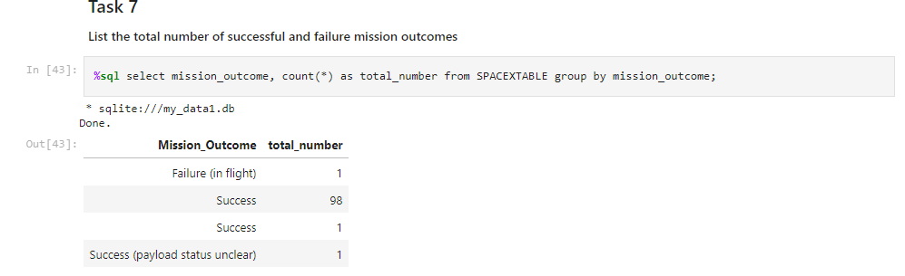
1(ii). Exploratory Data Analysis with SQL
Total Number of Successful and Failure Mission Outcomes
Outcome Count: A SQL query was used to count the total number of successful and failed mission outcomes, revealing 99 successful missions and 1 failure.

Slide 27
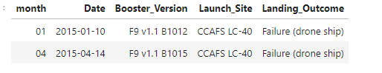
1(ii). Exploratory Data Analysis with SQL
2015 Launch Records
2015 Launch Failures: A SQL query was used to filter and list failed landing outcomes on a drone ship for the year 2015, identifying two specific booster versions that failed.

Slide 28
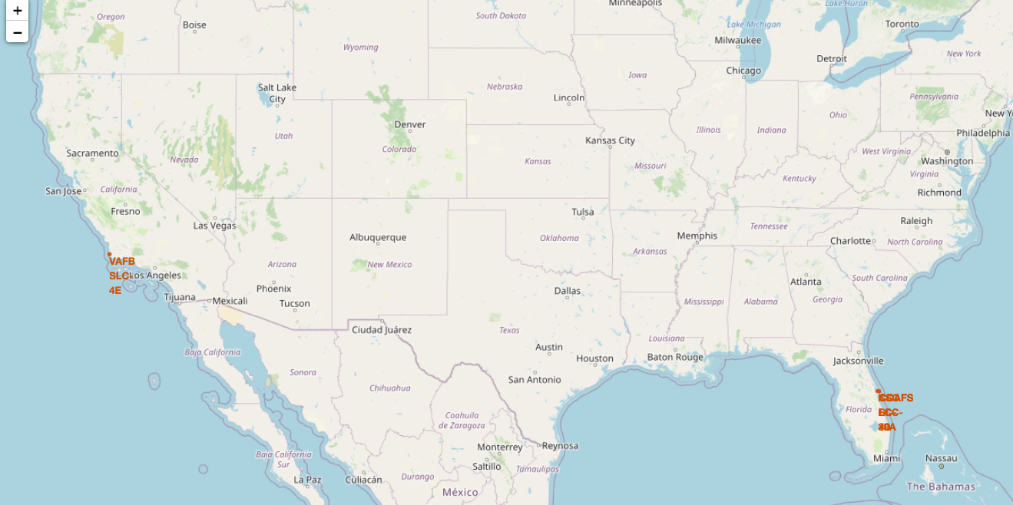
2. Interactive Analysis with Folium
All Launch Sites on a map
All SpaceX Launch Sites are in the United States of America, specifically at Florida and California

Slide 29
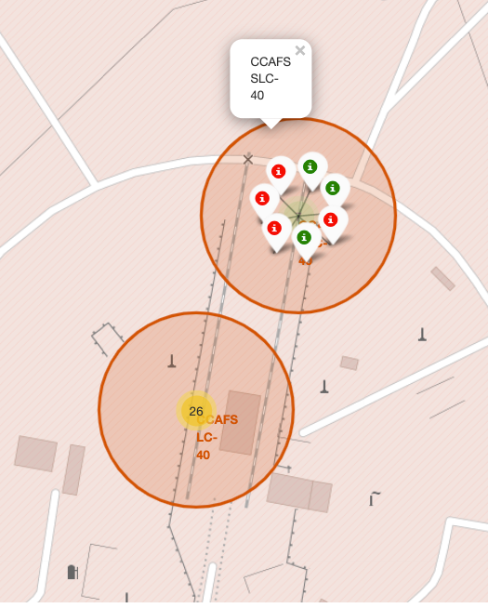
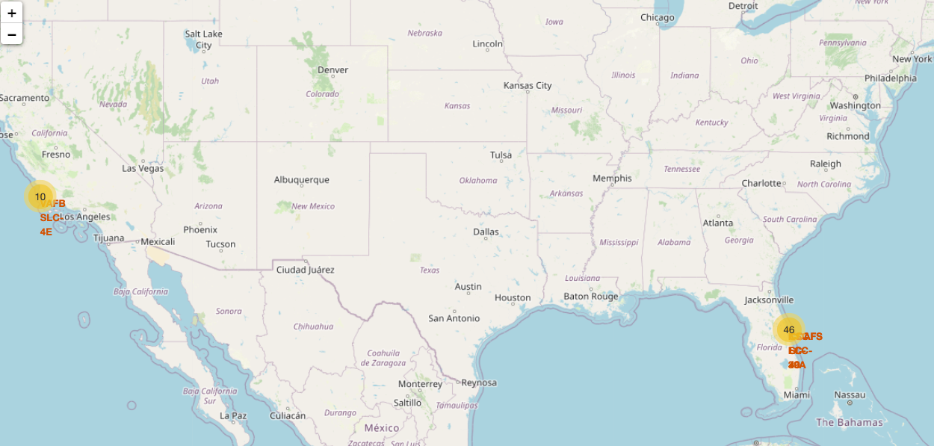
2. Interactive Analysis with Folium
Success/Failed Launch for Each Site
Launches are grouped in clusters, green representing successful launches and red representing failed ones.

Slide 30
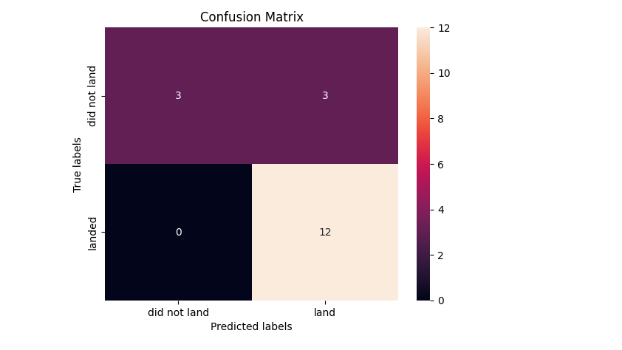
3. Predictive Analysis
Confusion Matrix
Model Performance: The confusion matrix for the decision tree classifier reveals that out of 18 predictions, 17 were correctly classified with a single false positive, where an unsuccessful landing was incorrectly marked as successful.

Slide 31
Conclusion
The larger the number of flights at a launch site, the greater the success rate, particularly post-2013.
Orbits like ES-L1, GEO, HEO, and SSO have the highest success rates, with 100% success observed.
The launch site KSC LC-39A had the most successful launches overall.
Heavier payloads generally experience lower success rates compared to lighter payloads.
The Decision Tree classifier was identified as the best machine learning algorithm for predicting landing outcomes.

